Slide 1
Phase diagram of water system
Dr.Vidya Francis
Assistant Professor
Department of Chemistry
Carmel College Mala

Slide 2
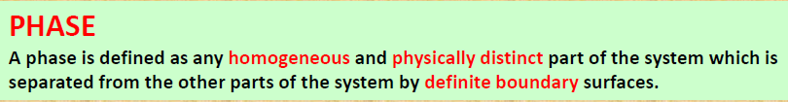

[P]

Slide 3
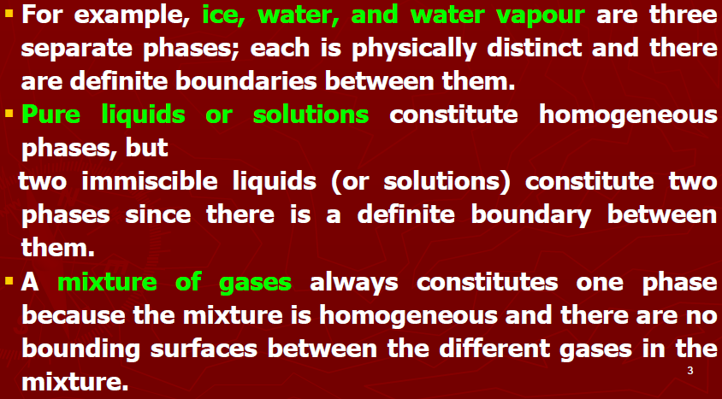

Slide 4
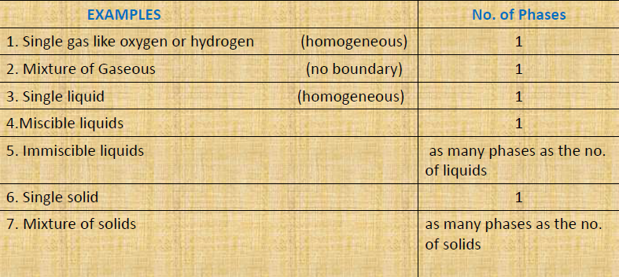
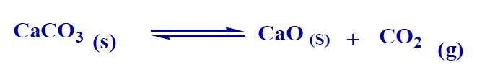

Slide 5
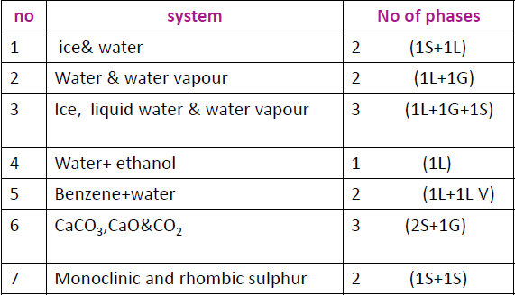

Slide 6
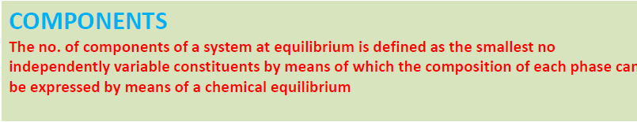
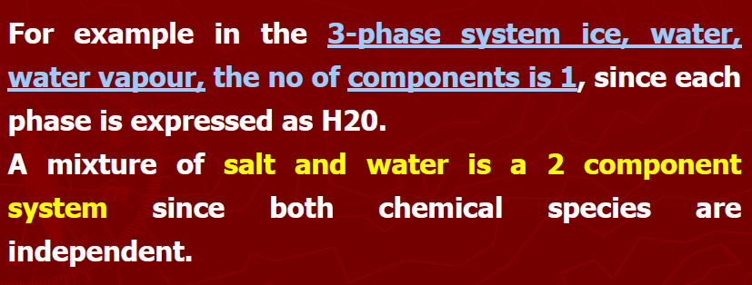
[C]

Slide 7

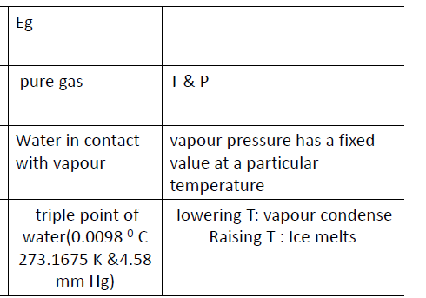
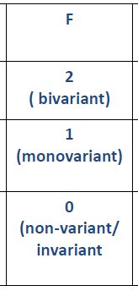
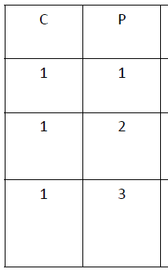
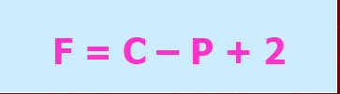
[F]

Slide 8
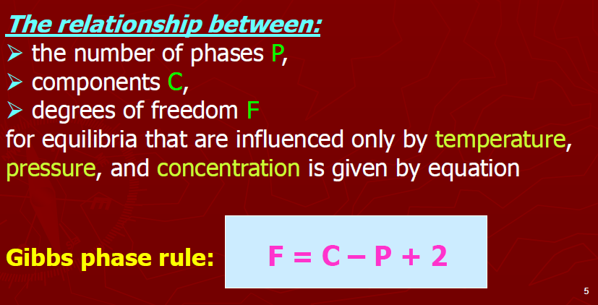

Slide 9
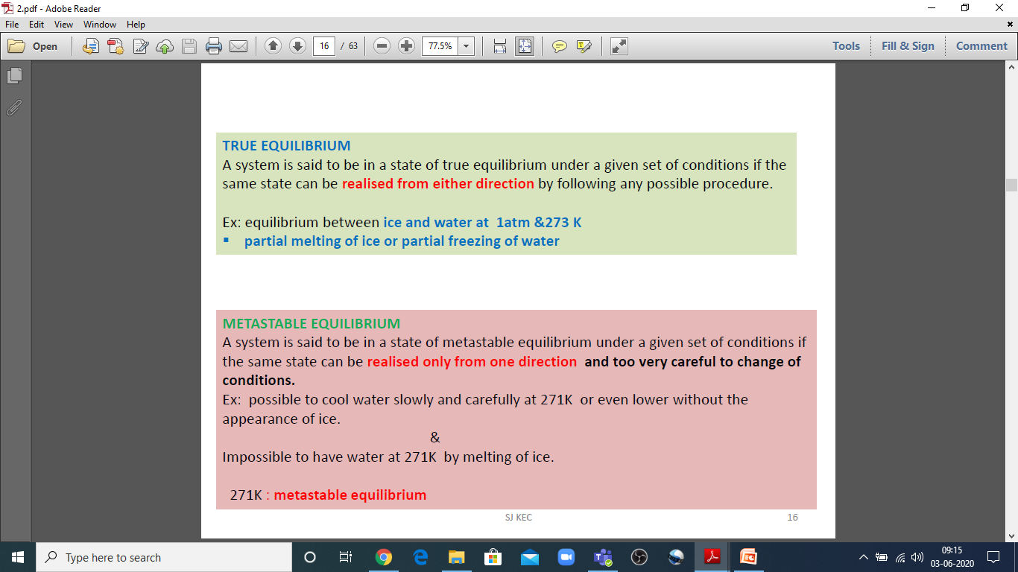

Slide 10
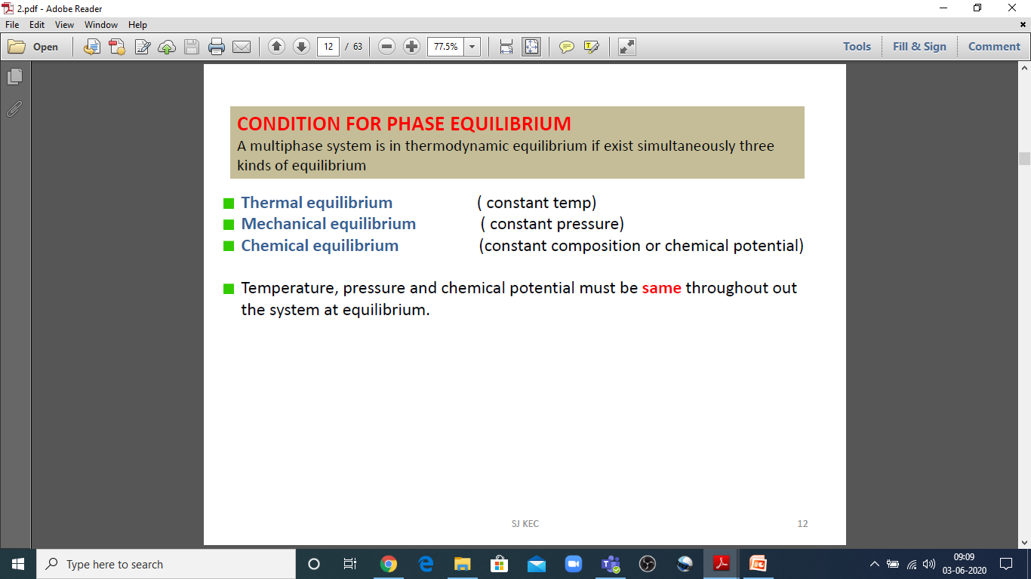

Slide 11
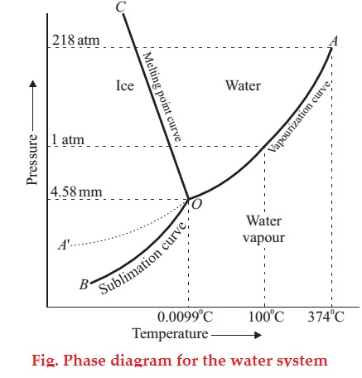

Application of Phase Rule to One Component System
(The Water System)
F = 1-P+2 = 3-P = 3-1 =2
AREAS
BOC
AOC
AOB
F = C-P+2
= 1-1+2
=2
CURVES
OA WATER VAPOUR
OB ICE VAPOUR
OC ICE WATER
F = C-P+2
= 1-2+2
=1

Slide 12
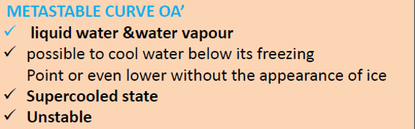

METASTABLE CURVE & TRIPPLE POINT
F = C-P+2
= 1-2+2
=1
F = C-P+2
= 1-3+2
=0

